Slide 1

Airway Management
CHAPTER 11

Slide 2
National EMS Education Standard Competencies (1 of 6)
Airway Management, Respiration, and Artificial Ventilation
Applies knowledge of general anatomy and physiology to patient assessment and management in order to assure a patent airway, adequate mechanical ventilation, and respiration for patients of all ages.
Notes:
National EMS Education Standard Competencies
Airway Management, Respiration, and Artificial Ventilation
Applies knowledge of general anatomy and physiology to patient assessment and management in order to assure a patent airway, adequate mechanical ventilation, and respiration for patients of all ages.

Slide 3
National EMS Education Standard Competencies (2 of 6)
Airway Management
Airway anatomy
Airway assessment
Techniques of assuring a patent airway
Notes:
National EMS Education Standard Competencies
Airway Management
• Airway anatomy
• Airway assessment
• Techniques of assuring a patent airway

Slide 4
National EMS Education Standard Competencies (3 of 6)
Respiration
Anatomy of the respiratory system
Physiology and pathophysiology of respiration
  Pulmonary ventilation
  Oxygenation
  Respiration (external, internal, cellular)
Notes:
National EMS Education Standard Competencies
Respiration
Anatomy of the respiratory system
Physiology and pathophysiology of respiration
Pulmonary ventilation
Oxygenation
Respiration
External
Internal
Cellular

Slide 5
National EMS Education Standard Competencies (4 of 6)
Respiration (cont’d)
Assessment and management of adequate and inadequate ventilation
Supplemental oxygen therapy
Notes:
National EMS Education Standard Competencies
Assessment and management of adequate and inadequate respiration
Supplemental oxygen therapy

Slide 6
National EMS Education Standard Competencies (5 of 6)
Artificial Ventilation
Assessment and management of adequate and inadequate ventilation
Artificial ventilation
Minute ventilation
Alveolar ventilation
Effect of artificial ventilation on cardiac output
Notes:
National EMS Education Standard Competencies
Assessment and management of adequate and inadequate ventilation
Artificial ventilation
• Minute ventilation
• Alveolar ventilation
• Effect of artificial ventilation on cardiac output

Slide 7
National EMS Education Standard Competencies (6 of 6)
Pathophysiology
Applies fundamental knowledge of the pathophysiology of respiration and perfusion to patient assessment and management.
Notes:
National EMS Education Standard Competencies
Pathophysiology
Applies fundamental knowledge of the pathophysiology of respiration and perfusion to patient assessment and management.

Slide 8
Introduction
The primary component of caring for patients is ensuring that they can breathe adequately.
When the ability to breathe is disrupted, oxygen delivery to tissues and cells is compromised.
Oxygen reaches body tissues and cells through breathing and circulation.
Notes:
Lecture Outline
I. Introduction
A. The single most important step in caring for patients is to address life threats, and a primary component of that step is to ensure that they can breathe adequately.
B. When the ability to breathe is disrupted, oxygen delivery to tissues and cells is compromised.
C. Oxygen reaches body tissues and cells through two separate but related processes: breathing and circulation.

Slide 9
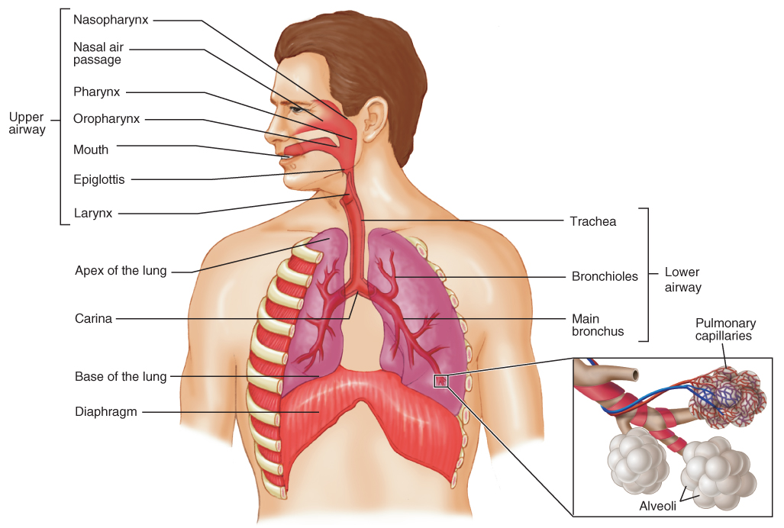
Anatomy of the Respiratory System (1 of 2)
FIGURE 11-1 The upper and lower airways contain the structures in the body that help us breathe.
© Jones & Bartlett Learning.
Notes:
The figure on this slide illustrates the upper and lower airways of the human body.

Slide 10
Anatomy of the Respiratory System (2 of 2)
The respiratory system consists of all the structures that make up the airway and help us breathe, or ventilate.
The airway is divided into the upper and lower airways.
Notes:
Lecture Outline
II. Anatomy of the Respiratory System
A. The respiratory system consists of all the structures that make up the airway and help us breathe, or ventilate.
B. The airway is divided into the upper and lower airways.

Slide 11
Anatomy of the Upper Airway (1 of 7)
Anatomy of the upper airway
  Nose
  Mouth
  Oral cavity
  Pharynx
  Larynx
Notes:
Lecture Outline
C. Anatomy of the upper airway
1. The upper airway consists of all anatomic airway structures above the vocal cords:
a. Nose
b. Mouth
c. Oral cavity
d. Pharynx
e. Larynx

Slide 12
Anatomy of the Upper Airway (2 of 7)
The upper airway’s main function is to warm, filter, and humidify air as it enters the body.
Pharynx
  Muscular tube extending from nose and mouth to level of esophagus and trachea
  Composed, from top to bottom, of the nasopharynx, oropharynx, and laryngopharynx
Notes:
Lecture Outline
2. The main function of the upper airway is to warm, filter, and humidify air as it enters the body.
3. Pharynx
a. Muscular tube extending from nose and mouth to the level of esophagus and trachea
b. Composed, from top to bottom, of the nasopharynx, oropharynx, and laryngopharynx

Slide 13
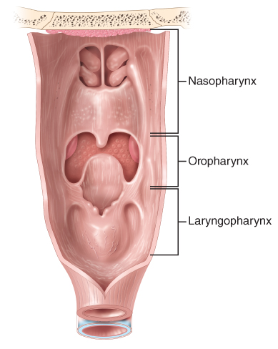
Anatomy of the Upper Airway (3 of 7)
Nasopharynx
  Filters out dust and small particles
  Warms and humidifies air as it enters the body
FIGURE 11-2 The pharynx.
© Jones & Bartlett Learning.
Notes:
Lecture Outline
4. Nasopharynx
a. Lined with ciliated mucous membrane that filters out dust and small particles
b. Warms and humidifies air as it enters the body

Slide 14
Anatomy of the Upper Airway (4 of 7)
Oropharynx
  Posterior portion of the oral cavity
  The epiglottis is superior to the larynx.
Notes:
Lecture Outline
5. Oropharynx
a. Posterior portion of the oral cavity
b. The epiglottis is superior to the larynx.
i. Helps prevent food and liquid from entering the larynx during swallowing

Slide 15
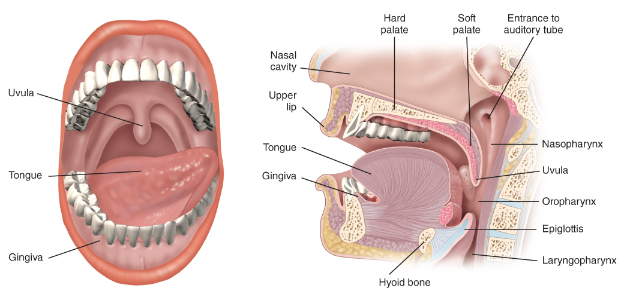
Anatomy of the Upper Airway (5 of 7)
FIGURE 11-3 The oral cavity.
© Jones & Bartlett Learning.
Notes:
The figure on this slide shows the oral cavity.

Slide 16
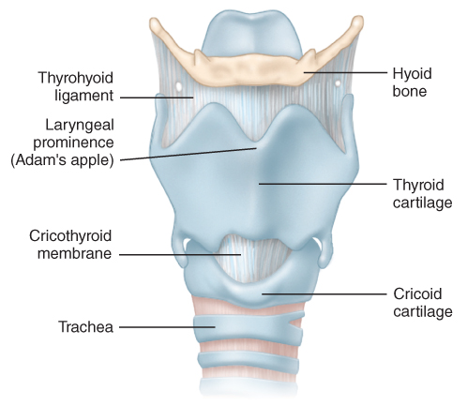
Anatomy of the Upper Airway (6 of 7)
Larynx
  Complex structure formed by many independent cartilaginous structures
  Marks where the upper airway ends, and the lower airway begins
FIGURE 11-6 The larynx.
© Jones & Bartlett Learning.
Notes:
Lecture Outline
6. Larynx
a. Complex structure formed by many independent cartilaginous structures
b. Marks where the upper airway ends, and the lower airway begins

Slide 17
Anatomy of the Upper Airway (7 of 7)
Larynx (cont’d)
  Thyroid cartilage forms a “V” shape anteriorly.
  Cricoid cartilage is the first ring of the trachea.
  Glottis is the area between the vocal cords.
Notes:
Lecture Outline
c. Thyroid cartilage forms a “V” shape anteriorly—the Adam’s apple.
d. Cricoid cartilage (cricoid ring): first ring of the trachea
e. Cricothyroid membrane is the elastic tissue that connects the thyroid superiorly to the cricoid ring inferiorly.
f. Glottis (glottis opening) is the area between the vocal cords.
i. Narrowest part of an adult’s airway
g. Vocal cords are white bands of thin muscle tissue.
i. Partially separated at rest
ii. Produce speech
iii. Protects the trachea from the entry of substances like water and vomitus

Slide 18
Anatomy of the Lower Airway (1 of 6)
The lower airway’s function is to deliver oxygen to the alveoli.
Lower airway includes:
  Trachea
  Bronchi
  Lungs
Notes:
Lecture Outline
D. Anatomy of the lower airway
1. The function of the lower airway is to deliver oxygen to the alveoli.

Slide 19
Anatomy of the Lower Airway (2 of 6)
Trachea
  Conduit for air entry into the lungs
  Divides at the carina into two main stem bronchi, right and left
  Bronchi are supported by cartilage.
  Bronchi distribute oxygen to the lungs.
Notes:
Lecture Outline
2. Elements of the lower airway
a. Trachea
i. Conduit for air entry into the lungs
ii. Begins directly below the cricoid cartilage
iii. Descends anteriorly down the midline of the neck into the thoracic cavity
b. In the thoracic cavity, the trachea divides at the carina into two main stem bronchi, right and left.
i. The bronchi are supported by cartilage.
ii. They distribute oxygen to the two lungs.
iii. On entering the lungs, each bronchus divides into ever-smaller bronchi, which divide into bronchioles.

Slide 20
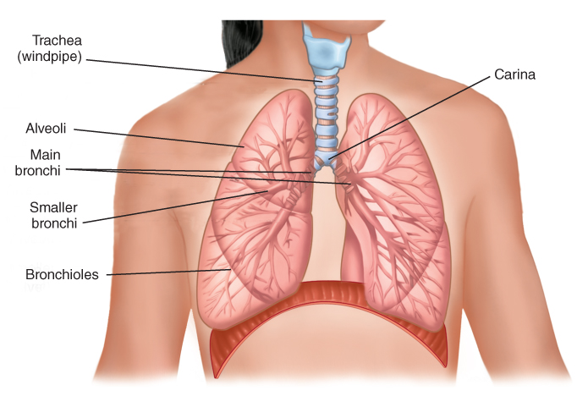
Anatomy of the Lower Airway (3 of 6)
FIGURE 11-7 The trachea and the lungs are lower airway structures.
© Jones & Bartlett Learning.
Notes:
The figure on this slide shows the trachea and lungs in the lower airway.

Slide 21
Anatomy of the Lower Airway (4 of 6)
Trachea (cont’d)
  Bronchioles are made of smooth muscle.
  Smaller bronchioles connect to alveoli.
  Oxygen is transported back to the heart and distributed to the rest of the body.
Notes:
Lecture Outline
iv. Bronchioles are made of smooth muscle; they dilate and constrict as oxygen passes through them.
v. Smaller bronchioles connect to alveoli.
(a) Site of oxygen and carbon dioxide exchange
(b) Millions of thin-walled, balloon-like sacs.
(c) Alveoli are surrounded by blood vessels (pulmonary capillaries).
(d) Oxygen diffuses across the alveolar membrane into the pulmonary capillaries.
vi. Oxygen in pulmonary capillaries is transported back to the heart and distributed to the rest of the body.
vii. Carbon dioxide diffuses from the pulmonary capillaries into the alveoli, where it is exhaled and removed from the body.

Slide 22
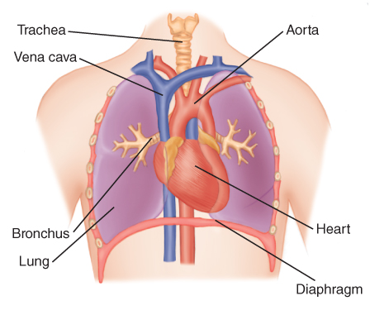
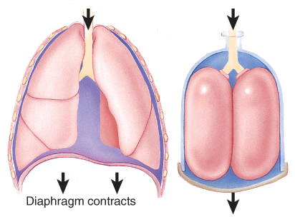
Anatomy of the Lower Airway (5 of 6)
The heart and great vessels (vena cava and aorta) are found in the thoracic cavity.
FIGURE 11-8 The thoracic cavity contains important
anatomic structures for ventilation, oxygenation, and
respiration, including the lungs and bronchi, heart, great vessels (the vena cavae and aorta), and trachea.
FIGURE 11-9 The mechanism of ventilation can be illustrated by using a bell jar. Inhalation and chest expansion, anatomic (left) and bell jar (right).
© Jones & Bartlett Learning.
© Jones & Bartlett Learning.
Notes:
Lecture Outline
3. The heart and great vessels (the vena cava and aorta) are also present in the thoracic cavity and are important for respiration.

Slide 23
Anatomy of the Lower Airway (6 of 6)
The mediastinum contains:
  Heart
  Great vessels
  Esophagus
  Trachea
  Major bronchi
  Many nerves
Notes:
Lecture Outline
a. The mediastinum is the area between the lungs, which contains:
i. Heart
ii. Great vessels
iii. Esophagus
iv. Trachea
v. Major bronchi
vi. Many nerves
b. The phrenic nerve is also found in the thorax.
i. Allows the diaphragm to contract, which is necessary for breathing to occur

Slide 24
Physiology of Breathing (1 of 2)
The respiratory and cardiovascular systems work together.
  Ensure a constant supply of oxygen and nutrients is delivered to cells
  Remove carbon dioxide and waste products
Notes:
Lecture Outline
III. Physiology of Breathing
A. The respiratory and cardiovascular systems work together.
1. Ensure that a constant supply of oxygen and nutrients is delivered to all of the cells of the body
2. Remove carbon dioxide and waste products from the cells

Slide 25
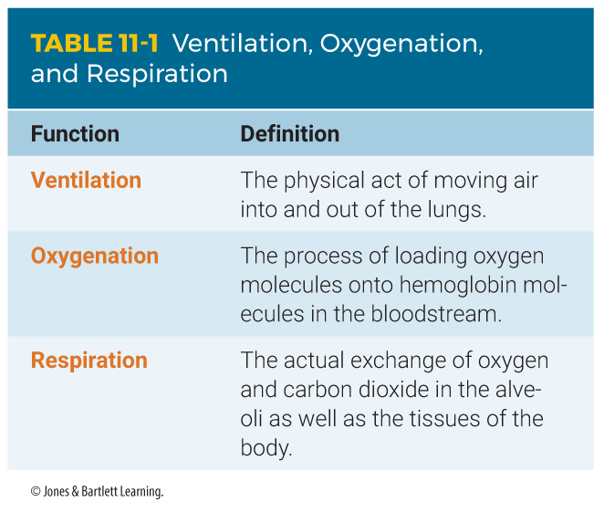
Physiology of Breathing (2 of 2)
Notes:
The table on this slide defines ventilation, oxygenation, and respiration.

Slide 26
Ventilation (1 of 6)
Physical act of moving air into and out of the lungs
Inhalation
  Active, muscular part of breathing
  The diaphragm and intercostal muscles contract.
  This generates a negative pressure in the thorax, allowing air to enter.
Notes:
Lecture Outline
B. The processes involved are ventilation, oxygenation, and respiration.
C. Ventilation
1. The physical act of moving air into and out of the lungs, which is necessary for oxygenation and respiration to occur
2. Inhalation
a. The active, muscular part of breathing
b. The diaphragm and intercostal muscles contract during inhalation, creating a negative pressure within the thorax, which allows air to enter the body and travel to the lungs.

Slide 27
Ventilation (2 of 6)
Inhalation (cont’d)
  The lungs require the movement of the chest and supporting structures to expand.
  Partial pressure: the amount of gas in the air or dissolved in fluid (blood)
  Oxygen and carbon dioxide both diffuse until the partial pressures in the air and the blood are equal.
Notes:
Lecture Outline
c. The lungs require the movement of the chest and supporting structures to expand and contract during inhalation and exhalation.
d. Partial pressure: the amount of gas in the air or dissolved in fluid, such as blood
i. The partial pressure of oxygen in the alveoli is 104 mm Hg.
ii. The partial pressure of carbon dioxide in the alveoli 40 mm Hg.
iii. Deoxygenated arterial blood from the heart has a partial pressure of oxygen that is lower than the partial pressure of carbon dioxide in the pulmonary capillaries.
iv. The body attempts to equalize the partial pressure, which results in oxygen diffusion across the membrane into the blood.
v. Oxygen and carbon dioxide both diffuse until the partial pressures in the air and the blood are equal.

Slide 28
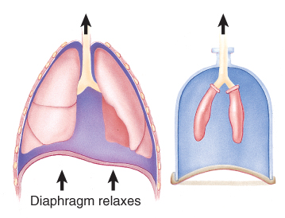
Ventilation (3 of 6)
FIGURE 11-9 The mechanism of ventilation can be illustrated by using a bell jar. Exhalation and chest contraction, anatomic (left) and bell jar (right).
© Jones & Bartlett Learning.
Notes:
The mechanism of ventilation can be illustrated by using a bell jar. A. Inhalation and chest expansion, anatomic (left) and bell jar (right). B. Exhalation and chest contraction, anatomic (left) and bell jar (right).

Slide 29
Ventilation (4 of 6)
Inhalation (cont’d)
  Inspiration delivers oxygen to the alveoli.
  Tidal volume
  Dead space
Notes:
Lecture Outline
e. Inspiration delivers oxygen to the alveoli.
i. Not all inspired air reaches the alveoli for gas exchange.
f. Tidal volume: a measure of depth of breathing
i. Tidal volume for an average adult is 500 mL.
g. Dead space is the portion of inspired air that fails to reach the alveoli

Slide 30
Ventilation (5 of 6)
Exhalation
  Does not normally require muscular effort
  Passive process
  Diaphragm and intercostal muscles relax.
  Smaller thorax compresses air into the lungs.
Notes:
Lecture Outline
3. Exhalation
a. Does not normally require muscular effort; it is a passive process.
b. The diaphragm and the intercostal muscles relax, which decreases the size of the thorax.
c. The smaller thorax compresses air in the lungs into a smaller space.
i. The air pressure in the thorax is then higher than the outside pressure.
ii. Air is pushed out through the trachea.

Slide 31
Ventilation (6 of 6)
Regulation of ventilation involves a complex series of receptors and feedback loops.
  Failure to meet the body’s need for oxygen may result in hypoxia.
  Based on pH changes in the blood and cerebrospinal fluid
Hypoxic drive
  Typically seen in patients with end-stage COPD
Notes:
Lecture Outline
4. Regulation of ventilation involves a complex series of receptors and feedback loops that sense gas concentrations in the body fluids and send messages to the respiratory center in the brain to adjust the rate and depth of ventilation.
a. The body’s need for oxygen is constantly changing.
b. Failure to meet this need may result in hypoxia, a condition in which the tissues and cells of the body to not get enough oxygen.
i. If not corrected, patients may die quickly.
5. Hypoxic drive
a. Differs from the primary control of breathing in that it uses levels of oxygen to control breathing.
b. Typically seen in patients with end-stage COPD.
c. Some believe that administering high levels of oxygen will increase the amount of oxygen dissolved in the plasma and negatively affect the body’s drive to breathe.

Slide 32
Oxygenation
Process of loading oxygen molecules onto hemoglobin molecules in bloodstream
Required for internal respiration to take place
  Does not guarantee that internal respiration is taking place
  Ventilation without oxygenation can occur where oxygen levels have been depleted.
Notes:
Lecture Outline
D. Oxygenation
1. The process of loading oxygen molecules onto hemoglobin molecules in the bloodstream
2. Required for internal respiration to take place
a. Oxygenation does not guarantee that internal respiration is taking place.
b. Ventilation without oxygenation can occur, in places where oxygen levels in the breathing air have been depleted, such as in mines or confined spaces, or high altitudes.

Slide 33
Respiration (1 of 3)
Actual exchange of oxygen and carbon dioxide in the alveoli and tissues of the body
Cells take energy from nutrients through metabolism.
Notes:
Lecture Outline
E. Respiration
1. The actual exchange of oxygen and carbon dioxide in the alveoli and in tissues of the body
2. Cells take energy from nutrients through a series of chemical processes known as metabolism (cellular respiration).
a. Each cell combines nutrients and oxygen, producing energy and waste products (mainly water and carbon dioxide).

Slide 34
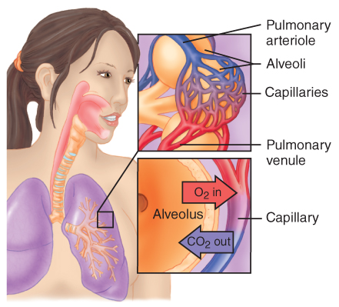
Respiration (2 of 3)
External respiration (pulmonary respiration)
  Brings fresh air into the respiratory system
  Exchanges oxygen and carbon dioxide between alveoli and blood in pulmonary capillaries
FIGURE 11-11 External respiration.
© Jones & Bartlett Learning.
Notes:
Lecture Outline
F. External respiration (pulmonary respiration)
1. The process of breathing fresh air into the respiratory system and exchanging oxygen and carbon dioxide between the alveoli and the blood in the pulmonary capillaries.
2. Surfactant reduces surface tension within the alveoli and keeps them expanded, making it easier for gas exchange to occur.

Slide 35
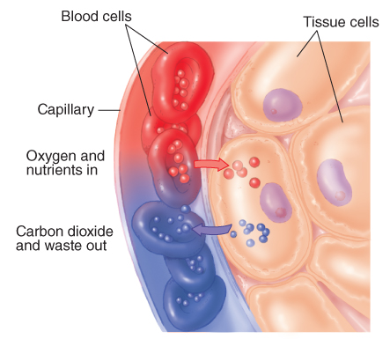
Respiration (3 of 3)
Internal respiration
  Exchange of oxygen and carbon dioxide between systemic circulatory system and cells
FIGURE 11-12 Internal respiration.
© Jones & Bartlett Learning.
Notes:
Lecture Outline
G. Internal respiration
1. Exchange of oxygen and carbon dioxide between the systemic circulatory system and the cells of the body
a. Oxygen passes from blood in the capillaries to tissue cells.
b. Carbon dioxide and cell wastes pass from the cells into the capillaries, where they are then transported via the venous system back to the lungs.
c. All cells need a constant supply of oxygen to survive.
d. When there is adequate oxygen, cells convert glucose into energy through aerobic metabolism.
e. Without adequate oxygen, anaerobic metabolism takes place, which cannot meet the metabolic demands of the cell.

Slide 36
Pathophysiology of Respiration (1 of 7)
Factors in the nervous system
  Chemoreceptors monitor levels of:
    Oxygen
    Carbon dioxide
    Hydrogen ions
    pH of cerebrospinal fluid
  Provide feedback to the respiratory centers
Notes:
Lecture Outline
IV. Pathophysiology of Respiration
A. Factors in the nervous system
1. Chemoreceptors monitor levels of oxygen, carbon dioxide, hydrogen ions, and the pH of cerebrospinal fluid and provide feedback to the respiratory centers.
2. When serum carbon dioxide or hydrogen ions levels increase, chemoreceptors stimulate the medulla to increase the respiratory rate.
3. Stimulation from the pons affects the rate and depth of respirations.

Slide 37
Pathophysiology of Respiration (2 of 7)
Ventilation/perfusion ratio and mismatch
  Air and blood flow must be directed to the same place at the same time.
  Ventilation and perfusion must be matched.
  Failure to match is the cause of most abnormalities of oxygen and carbon dioxide exchange.
Notes:
Lecture Outline
B. Ventilation/perfusion ratio and mismatch
1. Ventilation and perfusion must be directed to the same place at the same time.
2. Failure to match ventilation and perfusion is the cause of most abnormalities of oxygen and carbon dioxide exchange.

Slide 38
Pathophysiology of Respiration (3 of 7)
Ventilation/perfusion ratio and mismatch (cont’d)
  Gas exchange does not take place.
  Lack of O₂ in bloodstream
  CO₂ is recirculated within bloodstream.
  Severe hypoxemia can occur.
Notes:
Lecture Outline
a. When ventilation is compromised but perfusion continues, blood passes over some alveolar membranes without gas exchange taking place.
b. This results in a lack of oxygen diffusing across the membrane and into blood circulation.
c. Carbon dioxide is not able to diffuse across the membrane into the lungs and, therefore, recirculates within the bloodstream.
d. When perfusion across the alveolar membrane is disrupted optimal exchange of gases is prevented.

Slide 39
Pathophysiology of Respiration (4 of 7)
Factors affecting pulmonary ventilation
  Intrinsic factors:
    Infections
    Allergic reactions
    Unresponsiveness (tongue obstruction)
  Extrinsic factors:
    Trauma
Notes:
Lecture Outline
C. Factors affecting pulmonary ventilation
1. Intrinsic factors that can cause airway obstruction:
a. Infections
b. Allergic reactions
c. Unresponsiveness (eg, tongue obstruction)
2. Extrinsic factors that can cause airway obstruction:
a. Trauma

Slide 40
Pathophysiology of Respiration (5 of 7)
Factors affecting respiration
  External factors:
    Atmospheric pressure
    Partial pressure of O₂
  Internal factors:
    Pneumonia
    Pulmonary edema
    COPD/emphysema
Notes:
Lecture Outline
D. Factors affecting respiration
1. External factors, such as atmospheric pressure and the partial pressure of oxygen in the ambient environment
2. Internal factors, such as conditions that reduce the surface area for gas exchange and consequently decrease the body’s oxygen supply, leading to inadequate tissue perfusion (eg, pneumonia, pulmonary edema, and COPD/emphysema)

Slide 41
Pathophysiology of Respiration (6 of 7)
Circulatory compromise
  Trauma emergencies can obstruct blood flow to individual cells and tissue:
    Simple or tension pneumothorax
    Open pneumothorax
    Hemothorax
    Hemopneumothorax
Notes:
Lecture Outline
E. Circulatory compromise
1. Obstruction of blood flow to individual cells and tissue can be related to trauma emergencies:
a. Simple or tension pneumothorax
b. Open pneumothorax (sucking chest wound)
c. Hemothorax
d. Hemopneumothorax

Slide 42
Pathophysiology of Respiration (7 of 7)
Circulatory compromise (cont’d)
  Other causes:
    Blood loss
    Anemia
    Hypovolemic shock
    Vasodilatory shock
Notes:
Lecture Outline
2. Other causes of circulatory compromise:
a. Blood loss
b. Anemia
c. Hypovolemic shock
d. Vasodilatory shock

Slide 43
Patient Assessment (1 of 8)
Aerosol-generating procedures (AGPs)
  CPR
  Nebulizer treatments
  Endotracheal intubation
  Continuous positive airway pressure
Notes:
Lecture Outline
V. Patient Assessment
A. Wear a mask and protective eyewear that includes eye shields whenever airway management involves suctioning or an aerosol-generating procedure (AGP).
1. AGPs include CPR, nebulizer treatments, endotracheal intubation, and continuous positive airway pressure.

Slide 44
Patient Assessment (2 of 8)
Recognizing adequate breathing
  Between 12 and 20 breaths/min
  Regular pattern of inhalation and exhalation
  Bilateral clear and equal lung sounds
  Regular, equal chest rise and fall
  Adequate depth (tidal volume)
Notes:
Lecture Outline
B. Recognizing adequate breathing
1. Signs of normal breathing for adults:
a. 12–20 breaths/min
b. Regular pattern of inhalation and exhalation
c. Bilateral clear and equal lung sounds
d. Regular, equal chest rise and fall
e. Adequate depth (tidal volume)

Slide 45
Patient Assessment (3 of 8)
Recognizing abnormal breathing
  Fewer than 12 breaths/min
  More than 20 breaths/min
  Irregular rhythm
  Diminished, absent, or noisy auscultated breath sounds
  Reduced flow of expired air at nose and mouth
Notes:
Lecture Outline
C. Recognizing abnormal breathing
1. Signs of abnormal breathing:
a. Fewer than 12 breaths/min
b. More than 20 breaths/min in the presence of shortness of breath (dyspnea)
c. Irregular rhythm
d. Diminished, absent, or noisy auscultated breath sounds
e. Reduced flow of expired air at nose and mouth

Slide 46
Patient Assessment (4 of 8)
Recognizing abnormal breathing (cont’d)
  Unequal or inadequate chest expansion
  Increased effort of breathing
  Shallow depth
  Skin that is pale, cyanotic, cool, or moist
  Skin pulling in around ribs or above clavicles during inspiration
Notes:
Lecture Outline
f. Unequal or inadequate chest expansion, resulting in reduced tidal volume
g. Increased effort of breathing—use of accessory muscles
h. Shallow depth (reduced tidal volume)
i. Skin that is pale, cyanotic (blue), cool, or moist (clammy)
j. Skin pulling in around ribs or above clavicles during inspiration (retractions)

Slide 47
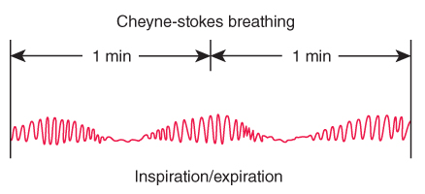
Patient Assessment (5 of 8)
A patient may appear to be breathing after the heart has stopped.
  Called agonal gasps
Cheyne-Stokes respirations are often seen in patients with stroke or head injury.
FIGURE 11-15 Cheyne-Stokes breathing shows irregular
respirations followed by a period of apnea.
© Jones & Bartlett Learning.
Notes:
Lecture Outline
2. A patient may appear to be breathing after the heart has stopped.
a. These occasional, gasping breaths are called agonal gasps.
3. Cheyne-Stokes respirations are often seen in patients with stroke or head injury.
a. Breathing with increasing rate and depth of respirations followed by apnea

Slide 48
Patient Assessment (6 of 8)
Ataxic respirations
  Irregular or unidentifiable pattern
  May follow serious head injuries
Kussmaul respirations
  Deep, rapid respirations
  Common in patients with metabolic acidosis
Patients with inadequate breathing need to be treated immediately.
Notes:
Lecture Outline
4. Ataxic respirations have an irregular or unidentifiable pattern and may follow serious head injuries.
5. Patients experiencing a metabolic or toxic disorder may display other abnormal respiratory patterns such as Kussmaul respirations.
a. Kussmaul respirations: deep, rapid respirations commonly seen in patients with metabolic acidosis
6. Patients with inadequate breathing need to be treated immediately.

Slide 49
Patient Assessment (7 of 8)
Assessment of respiration
  Even though the patient may be ventilating appropriately, respiration may be compromised.
  Level of consciousness and skin color are excellent indicators of respiration.
Notes:
Lecture Outline
7. Emergency medical care:
a. Airway management
b. Supplemental oxygen
c. Ventilatory support
D. Assessment of respiration
1. Even though the patient may be ventilating appropriately, the actual exchange of oxygen and carbon dioxide at the tissue level may still be compromised by several factors:
a. High altitudes
b. Poisonous gases, including carbon monoxide
c. Enclosed spaces
2. A patient’s level of consciousness and skin color are excellent indicators of respiration.

Slide 50
Patient Assessment (8 of 8)
Assessment of respiration (cont’d)
  Also consider oxygenation
    Pulse oximetry is considered a routine vital sign.
    Can be used as part of any patient assessment
Notes:
Lecture Outline
3. When assessing patients, consider proper oxygenation, which can be assessed by pulse oximetry.
4. Oxygen saturation (Spo₂) is a measure of the percentage of hemoglobin molecules that are bound in arterial blood.
a. A pulse oximeter measures the percentage of hemoglobin saturation.
i. Spo₂ should be greater than 94% while breathing room air.
ii. In conditions such as stroke or heart attack, oxygen is applied when the Spo₂ is less than 94%.
iii. Pulse oximeters can take as long as 60 seconds to reflect changes in a patient’s oxygenation status; the patient can develop respiratory insufficiency well before the pulse oximetry values begin to decline.
iv. Pulse oximetry is considered a routine vital sign and can be used as part of any patient assessment (see Skill Drill 11-1).

Slide 51
End-tidal CO₂ (1 of 2)
Measurement of the maximal CO₂ at the end of an exhaled breath.
Low CO₂ level
  Hyperventilation
  Decreased CO₂ return to the lungs
  Reduced CO₂ production at the cellular level
High CO₂ level
  Ventilatory inadequacy
  Apnea
Notes:
5. End-tidal CO₂ is the measurement of the maximal concentration of CO₂ at the end of an exhaled breath.
a. A low CO₂ level could indicate:
i. Hyperventilation
ii. Decreased CO₂ return to the lungs
iii. Reduced CO₂ production at the cellular level
b. A high CO₂ level may indicate:
i. The patient retaining CO₂ secondary to ventilation inadequacy
ii. Apnea

Slide 52
End-tidal CO₂ (2 of 2)
Measured using capnometry and capnography devices
Normal range is 35–45 mm Hg
Can be used in spontaneously breathing patients with a special nasal cannula
Notes:
6. End-tidal CO₂ is measured using capnometry and capnography devices
a. Capnometry refers to use of a device that provides a digital numeric reading of the end-tidal CO₂ level.
b. Capnography provides both a numeric reading and a graph, from breath to breath.
c. Normal range is 35 to 45 mm Hg.
d. Can be used in spontaneously breathing patients with an adequate airway using a special nasal cannula.

Slide 53
Opening the Airway (1 of 2)
Emergency medical care begins with ensuring an open airway.
Rapidly assess whether an unconscious patient has an open airway and is breathing adequately.
  Position the patient correctly.
  Supine position is most effective.
Notes:
Lecture Outline
VI. Opening the Airway
A. Emergency medical care begins with ensuring an open airway.
1. Rapidly assess whether an unconscious patient has a patent airway and pulse and is breathing adequately.
2. Position the patient in a supine position.
a. Unconscious patients should be moved as a unit because of the potential for spinal injury (see Skill Drill 11-2).

Slide 54
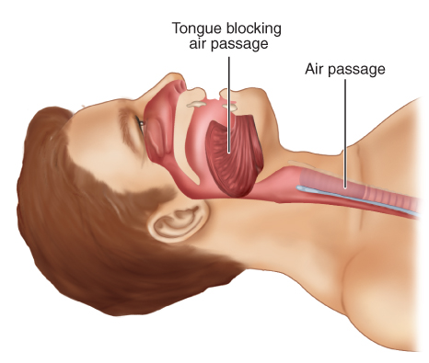
Opening the Airway (2 of 2)
Unconscious patients should be moved as a unit.
  Most common airway obstruction is the tongue.
FIGURE 11-23 The most common airway obstruction is
the patient’s own tongue, which falls back into the throat when the muscles of the throat and tongue relax.
© Jones & Bartlett Learning.
Notes:
Lecture Outline
b. In an unconscious patient, the most common airway obstruction is the patient’s tongue, which falls back into the throat when the muscles of the throat and tongue relax.

Slide 55
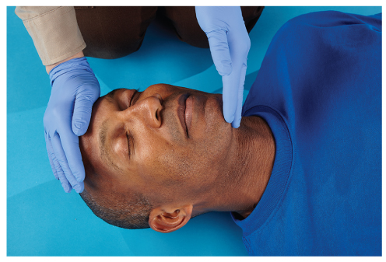
Head Tilt–Chin Lift Maneuver (1 of 2)
Will open the airway in most patients
For patients who have not sustained or are not suspected of having sustained trauma
FIGURE 11-24 The head tilt–chin lift maneuver is a simple technique for opening the airway in a patient without a suspected cervical spine injury.
© Jones & Bartlett Learning.
Notes:
Lecture Outline
B. Head tilt–chin lift maneuver
1. Will open the airway in most patients
2. For patients who have not sustained or are not suspected of having sustained spinal trauma, this simple maneuver is sometimes all that is needed for the patient to resume breathing.

Slide 56
Head Tilt–Chin Lift Maneuver (2 of 2)
Follow these steps:
  With the patient supine, position yourself beside the patient’s head.
  Place the heel of one hand on the forehead, and apply firm backward pressure with the palm.
  Place the fingertips of the other hand under the lower jaw.
  Lift the chin upward, with the entire lower jaw.
Notes:
Lecture Outline
3. Follow these steps:
a. With the patient supine, position yourself beside the patient’s head.
b. Place the heel of one hand on the patient’s forehead and apply firm backward pressure with the palm.
c. Place the fingertips of the other hand under the patient’s lower jaw.
d. Lift the chin upward, with the entire lower jaw, helping to tilt the head back.

Slide 57
Jaw-Thrust Maneuver
If you suspect a cervical spine injury, use this maneuver.
Follow these steps:
  Kneel above the patient’s head.
  Place your fingers behind the angles of the lower jaw.
  Move the jaw upward.
  Use your thumbs to help position the jaw.
Notes:
Lecture Outline
C. Jaw-thrust maneuver
1. If you suspect a cervical spine injury, use the jaw-thrust maneuver.
2. Follow these steps:
a. Kneel above the patient’s head.
b. Place your fingers behind the angles of the lower jaw.
c. Move the jaw upward.
d. Use your thumbs to help position the lower jaw.

Slide 58
Opening the Mouth (1 of 2)
Even if the airway is opened, the mouth may be closed.
For the cross-finger technique:
  Place the tips of your index finger and thumb on the patient’s teeth.
  Push your thumb on the lower teeth.
  Push index finger on the upper teeth.
  The index finger and the thumb cross over each other.
Notes:
Lecture Outline
D. Opening the mouth
1. Even though you may have opened the airway with a head tilt–chin lift or jaw-thrust maneuver, the patient’s mouth may be closed.
a. To open the mouth, place the tips of your index finger and thumb on the patient’s teeth.
b. Open the mouth by pushing your thumb on the lower teeth and index finger on the upper teeth.
c. The pushing motion will cause the index finger and the thumb to cross over each other, which is why this is called the cross-finger technique.

Slide 59
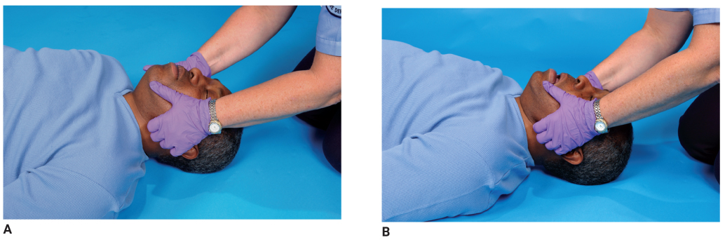
Jaw-Thrust Maneuver (2 of 2)
FIGURE 11-25 Performing the jaw-thrust maneuver.
A. Kneeling above the patient’s head, place your fingers behind the angles of the lower jaw, and move the jaw upward. Use your thumbs to help position the lower jaw.
B. The completed maneuver should look like this.
A, B: © Jones & Bartlett Learning. Courtesy of MIEMSS.
Notes:
The photos on this slide demonstrate how to perform the jaw-thrust maneuver. A. Kneeling above the patient’s head, place your fingers behind the angles of the lower jaw, and move the jaw upward. Use your thumbs to help position the lower jaw. B. The completed maneuver should look like the second photo.

Slide 60
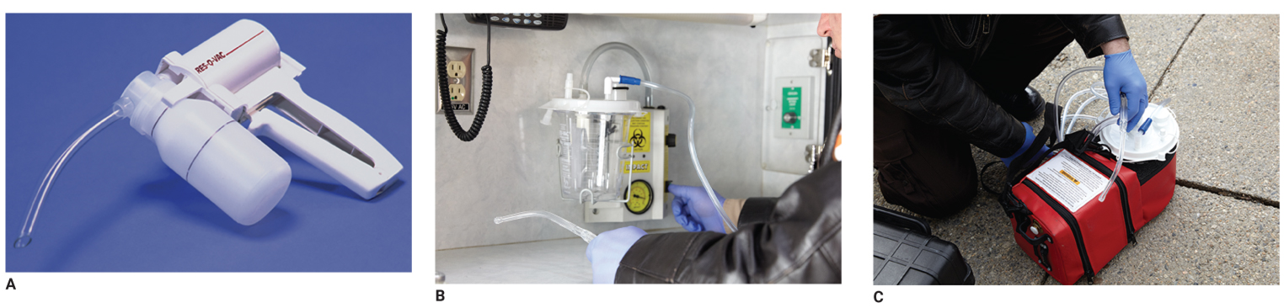
Suctioning (1 of 2)
You must keep the airway clear to ventilate properly.
Portable, hand-operated, and fixed equipment is essential for resuscitation.
FIGURE 11-27 Suctioning equipment is essential for resuscitation. A. Hand-operated unit. B. Fixed unit.
C. Portable unit.
A, C: © Jones & Bartlett Learning. Courtesy of MIEMSS. B: © Jones & Bartlett Learning.
Notes:
Lecture Outline
VII. Suctioning
A. You must keep the airway clear to ventilate the patient properly.
1. If the airway is not clear, you will force the fluids and secretions into the lungs resulting in aspiration.
2. If you hear gurgling, the patient needs suctioning.
B. Suctioning equipment
1. Portable, hand-operated, and fixed (mounted) equipment is essential for resuscitation.
a. A portable suctioning unit must provide enough vacuum pressure and flow to allow you to suction the mouth and nose effectively.
b. Hand-operated suctioning units with disposable chambers are reliable, effective, and relatively inexpensive.
c. A fixed suctioning unit should generate airflow of more than 40 L/min and a vacuum of more than 300 mm Hg when the tubing is clamped.

Slide 61
Suctioning (2 of 2)
A portable or fixed unit should have:
  Wide-bore, thick-walled, nonkinking tubing
  Plastic, rigid pharyngeal suction tips
  Nonrigid plastic catheters
  A nonbreakable, disposable collection bottle
  Water supply for rinsing the tips
Notes:
Lecture Outline
2. A portable or fixed unit should be fitted with the following:
a. Wide-bore, thick-walled, nonkinking tubing
b. Plastic, rigid pharyngeal suction tips, called tonsil tips (Yankauer tips or DuCanto catheter).
i. Best kind of catheter for infants and children.
ii. The large-diameter plastic tips are rigid and do not collapse.
c. Nonrigid plastic catheters, called French or whistle-tip catheters
i. Used to suction the nose and liquid secretions in the back of the mouth and in situations when you cannot use a rigid catheter.
d. Nonbreakable, disposable collection bottle
e. Water supply for rinsing the tips
3. Before inserting any catheter, measure for the proper size.
a. Use the same technique as when measuring for an oropharyngeal airway.

Slide 62
Techniques of Suctioning (1 of 4)
Inspect the equipment regularly.
To operate the suction unit:
  Check the unit for proper assembly of its parts.
  Test the suctioning unit to ensure vacuum pressure of more than 300 mm Hg.
  Select and attach the appropriate suction catheter to the tubing.
Notes:
Lecture Outline
C. Techniques of suctioning
1. Inspect your suctioning equipment regularly.
2. Steps to operate the suction unit:
a. Check the unit for proper assembly of all its parts.
b. Turn on the suctioning unit and test it to ensure a vacuum pressure of more than 300 mm Hg.
c. Select and attach the appropriate suction catheter to the tubing.

Slide 63
Techniques of Suctioning (2 of 4)
Never suction the mouth or nose for more than 15 seconds at one time for adult patients, 10 seconds for children, and
5 seconds for infants.
  Suctioning can result in hypoxia.
Notes:
Lecture Outline
3. Never suction the mouth or nose for more than 15 seconds at one time for adult patients, 10 seconds for children, and 5 seconds for infants.
a. Suctioning can result in hypoxia.
b. Rinse the catheter and tubing with water to prevent clogging.
c. Repeat suctioning only after the patient has been adequately ventilated and reoxygenated.
d. Do not touch the back of the airway with a suction catheter-this can activate the gage reflex.
4. To properly suction a patient, see Skill Drill 11-3.

Slide 64
Techniques of Suctioning (3 of 4)
When patients have secretions or vomitus that cannot be suctioned easily:
  Remove the catheter from the patient’s mouth.
  Log roll the patient to the side.
  Clear the mouth carefully with a gloved finger.
Notes:
Lecture Outline
5. Sometimes a patient may have secretions or vomitus that cannot be suctioned quickly and easily, and some units cannot remove objects such as teeth, foreign bodies, and food. In these cases:
a. Remove the catheter from the patient’s mouth.
b. Log roll the patient to the side.
c. Clear the mouth carefully with a gloved finger.

Slide 65
Techniques of Suctioning (4 of 4)
If the patient produces frothy secretions as quickly as you can suction them:
  Suction the airway for 15 seconds (less in infants and children).
  Ventilate for 2 minutes.
  Continue this alternating pattern until all secretions have been cleared.
Notes:
Lecture Outline
6. If a patient who requires assisted ventilations produces frothy secretions as quickly as you can suction them:
a. Suction the airway for 15 seconds (less in infants and children).
b. Ventilate for 2 minutes.
c. Continue this alternating pattern of suctioning and ventilating until all secretions have been cleared from the airway.

Slide 66
Basic Airway Adjuncts (1 of 4)
Prevent obstruction by the tongue and allow for passage of air and oxygen to the lungs
Oropharyngeal airways
  Keep the tongue from blocking the upper airway
  Make it easier to suction the oropharynx
Notes:
Lecture Outline
VIII. Basic Airway Adjuncts
A. An airway adjunct prevents obstruction of the upper airway by the tongue and allows for passage of air and oxygen to the lungs.
B. Oropharyngeal airways
1. Keep the tongue from blocking the upper airway and make it easier to suction the oropharynx

Slide 67
Basic Airway Adjuncts (2 of 4)
Oropharyngeal airways (cont’d)
  Indications:
    Unresponsive patients without a gag reflex
    Apneic patients being ventilated with a bag-mask device
  Contraindications:
    Conscious patients
    Any patient who has an intact gag reflex
Notes:
Lecture Outline
2. Indications:
a. Unresponsive patients without a gag reflex (breathing or apneic)
b. Apneic patients being ventilated with a bag-mask device
3. Contraindications:
a. Conscious patients
b. Any patient (conscious or unconscious) who has an intact gag reflex
4. An oral airway that is too large could push the tongue back into the pharynx, blocking the airway.
5. An oral airway that is too small could block the airway directly, like any foreign body obstruction.
6. To insert the airway properly, see Skill Drill 11-4.
7. If you encounter difficulty inserting the oral airway, an alternative method may be used: inserting with a 90° rotation (see Skill Drill 11-5).

Slide 68
Basic Airway Adjuncts (3 of 4)
Nasopharyngeal airways
  Used in a patient who:
    Is unresponsive or has an altered LOC
    Has an intact gag reflex
    Is unable to maintain his or her own airway spontaneously
Notes:
Lecture Outline
C. Nasopharyngeal airways
1. Used with a patient who has an intact gag reflex, but is unable to maintain his or her own airway spontaneously

Slide 69
Basic Airway Adjuncts (4 of 4)
Nasopharyngeal airways (cont’d)
  Indications:
    Semiconscious or unconscious patients with an intact gag reflex
    Patients who will not tolerate an oropharyngeal airway
  Contraindications:
    Severe head injury with blood in the nose
    History of fractured nasal bone
Notes:
Lecture Outline
2. Indications:
a. Semiconscious or unconscious patients with an intact gag reflex
b. Patients who otherwise will not tolerate an oropharyngeal airway
3. Contraindications:
a. Severe head injury with blood draining from the nose
b. History of fractured nasal bone
4. To insert the airway correctly, see Skill Drill 11-6.

Slide 70
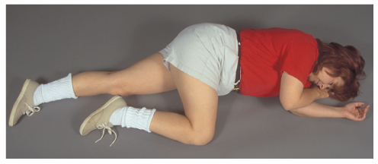
Maintaining the Airway
Use the recovery position.
  Used to help maintain a clear airway in an unconscious patient who is not injured and is breathing on his or her own
FIGURE 11-32 In the recovery position, the patient is rolled
onto his or her left or right side.
© Jones & Bartlett Learning. Courtesy of MIEMSS.
Notes:
Lecture Outline
IX. Maintaining the Airway
A. The recovery position is used to help maintain a clear airway in an unconscious patient who is not injured and is breathing on his or her own with a normal respiratory rate and adequate tidal volume.

Slide 71
Supplemental Oxygen (1 of 9)
Always give oxygen to patients who are hypoxic.
  Some tissues and organs need a constant supply of oxygen to function normally.
Never withhold oxygen from any patient who might benefit from it.
Notes:
Lecture Outline
X. Supplemental Oxygen
A. Always give supplemental oxygen to patients who are hypoxic, because not enough oxygen is being supplied to the tissues and cells of the body.
1. Some tissues and organs, such as the heart, central nervous system, lungs, kidneys, and liver, need a constant supply of oxygen to function normally.
2. Never withhold oxygen from any patient who might benefit from it, especially if you must assist ventilations.

Slide 72
Supplemental Oxygen (2 of 9)
Supplemental oxygen equipment
  Oxygen cylinders contain compressed gas.
  Liquid oxygen is becoming a more commonly used alternative.
Notes:
Lecture Outline
B. Supplemental oxygen equipment
1. Oxygen cylinders
a. The oxygen that you will give to patients is usually supplied as a compressed gas in green, steel or aluminum cylinders.
b. Check that the cylinder is labeled for medical oxygen. Look for letters and numbers stamped into the metal on the collar of the cylinder.
i. Check the month and year stamps indicating when the cylinder was last tested.
ii. Aluminum cylinders are tested every 5 years.
iii. Composite cylinders are tested every 3 years.
c. Most often the D (or jumbo D) cylinder sizes will be used as portable tanks.
d. The length of time you can use an oxygen cylinder depends on the pressure in the cylinder and the flow rate.
2. Liquid oxygen is becoming a more commonly used alternative to compressed gas oxygen.

Slide 73
Supplemental Oxygen (3 of 9)
Safety considerations
  Handle gas cylinders carefully.
  Make sure the correct pressure regulator is firmly attached before transport.
  A puncture hole in a tank can turn it into a deadly missile.
  Secure cylinders when stored on ambulance and when in use during transport.
Notes:
Lecture Outline
3. Safety considerations
a. Handle gas cylinders carefully because their contents are under pressure.
b. Make sure the correct pressure regulator is firmly attached before transporting cylinders.
c. A puncture or hole in a tank can turn it into a deadly missile.
d. Secure cylinders with mounting brackets when they are stored on the ambulance.
e. Oxygen cylinders that are in use during transport should be positioned correctly and secured.

Slide 74
Supplemental Oxygen (4 of 9)
Pin-indexing system
  Prevents such mistakes as an oxygen regulator being accidentally connected to a carbon dioxide cylinder
  Every cylinder of a specific gas type has a given pattern and a given number of pins.
Notes:
Lecture Outline
4. Pin-indexing system
a. Each portable cylinder of a specific gas type has a given pattern and a given number of pins, following accepted national standards.
b. This pin-indexing system prevents an oxygen regulator being accidently connected to an incorrect gas cylinder.
c. When preparing to administer oxygen, check that the pinholes on the cylinder exactly match the corresponding pins on the regulator.
d. For large cylinders, the safety system is the American Standard Safety System.
i. Oxygen cylinders are equipped with threaded gas outlet valves.
ii. Inside and outside thread sizes vary depending on the gas in the cylinder, preventing accidental attachment of a regulator to a wrong cylinder.

Slide 75
Supplemental Oxygen (5 of 9)
Pressure regulators
  Reduce the cylinder’s pressure to a useful therapeutic range, usually 40 to 70 psi.
  Final attachment for delivering the gas is either a quick-connect female fitting or a flowmeter.
Notes:
Lecture Outline
5. Pressure regulators
a. Reduce the cylinder’s pressure to a useful therapeutic range for the patient—usually 40 to 70 psi.
b. After the pressure is reduced to a workable level, the final attachment for delivering the gas is one of the following:
i. A quick-connect female fitting that will accept a quick-connect male plug from a pressure hose or ventilator/resuscitator
ii. A flowmeter that will permit the regulated release of gas measured in liters per minute

Slide 76
Supplemental Oxygen (6 of 9)
Flowmeters
  Usually permanently attached to pressure regulators on emergency medical equipment
  Pressure-compensated flowmeter
  Bourdon-gauge flowmeter
Notes:
Lecture Outline
6. Flowmeters
a. Usually permanently attached to pressure regulators on emergency medical equipment
b. A pressure-compensated flowmeter incorporates a float ball within a tapered calibrated tube.; is affected by gravity and must always be upright
c. The Bourdon-gauge flowmeter is a gauge calibrated to record flow rate; can be used in any position

Slide 77
Supplemental Oxygen (7 of 9)
Hazards of supplemental oxygen:
  Combustion
  Oxygen toxicity
Notes:
Lecture Outline
C. Procedures for operating and administering oxygen
1. To place an oxygen cylinder into service and administer medical oxygen to a patient, see Skill Drill 11-7.
D. Hazards of supplemental oxygen

Slide 78
Supplemental Oxygen (8 of 9)
Combustion
  Oxygen does not burn or explode, but it does speed up the combustion process.
  Keep any sources of fire away.
  Make sure the area is adequately ventilated.
  Never leave an oxygen cylinder standing unattended.
Notes:
Lecture Outline
1. Combustion
a. Oxygen does not burn or explode; it does speed up the combustion process.
b. Keep any possible source of fire away from the area while oxygen is in use.
c. Make sure the area is adequately ventilated, especially in industrial settings.
d. Never leave an oxygen cylinder standing unattended.

Slide 79
Supplemental Oxygen (9 of 9)
Oxygen toxicity
  Not all patients need high concentrations of oxygen.
  Oxygen can have detrimental effects in patients with certain illnesses (COPD).
  When pulse oximetry available, tailor oxygen therapy; administer the minimum amount necessary to maintain oxygen saturation at or above 94%.
Notes:
Lecture Outline
2. Oxygen toxicity
a. Not all patients require high-flow oxygen.
b. Excessive supplemental oxygen can have a detrimental effect on patients with certain illnesses (i.e., COPD, cerebrovascular accidents, and myocardial infarction).
c. Oxygen toxicity refers to damage to cellular tissue due to excessive oxygen levels in the blood.
d. Increased cellular oxygen levels contribute to the production of oxygen free radicals, which can lead to tissue damage and cellular death in some patients.
e. The International Liaison Committee on Resuscitation guidelines published by the American Heart Association recognize there may be negative effects of oxygen toxicity and recommend that oxygen be administered to patients experiencing signs of a myocardial infarction when they have signs of heart failure, are short of breath, or have a room air oxygen saturation less than 94%.
i. Patients experiencing signs of shock should be placed on oxygen.
ii. Hypoxemia is much worse than oxygen toxicity; when in doubt, or if unable to measure oxygen saturation reliably, supplemental oxygen should be administered.
f. When pulse oximetry is available, tailor oxygen therapy to the patient’s needs and administer the minimum amount of oxygen necessary to maintain oxygen saturation at or above 94%.

Slide 80
Oxygen-Delivery Equipment
Nonrebreathing masks
Bag-mask devices
Nasal cannulas
Notes:
Lecture Outline
XI. Oxygen-Delivery Equipment
A. In general, oxygen-delivery equipment used in the field should be limited to nonrebreathing masks, bag-mask devices, and nasal cannulas.

Slide 81
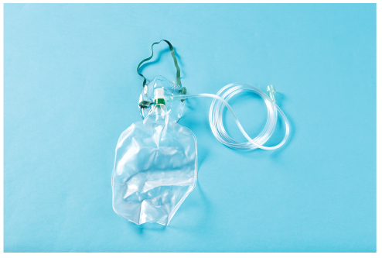
Nonrebreathing Masks (1 of 2)
Preferred way to give oxygen in the prehospital setting
  Patients who are breathing adequately but are suspected of having hypoxia
Combination mask and reservoir bag system
FIGURE 11-39 The nonrebreathing mask contains flapper valve ports at the cheek areas of the mask to prevent the patient from rebreathing exhaled gases.
© Jones & Bartlett Learning
Notes:
Lecture Outline
B. Nonrebreathing masks
1. Combines a mask with a reservoir bag system
a. Oxygen fills a reservoir bag attached to the mask by a one-way valve.
b. Exhaled gas escapes through flapper valve ports at cheek areas of the mask.
c. Prevents the patient from rebreathing exhaled gases

Slide 82
Nonrebreathing Masks (2 of 2)
Make sure the reservoir bag is full before placing the mask on the patient.
Adjust the flow rate so the bag does not collapse when the patient inhales.
When oxygen therapy is discontinued, remove the mask.
Notes:
Lecture Outline
2. Make sure the reservoir bag is full before placing the mask on the patient.
3. Adjust the flow rate so the bag does not collapse when the patient inhales.
a. Usually 10–15 L/min
b. If the bag does collapse, increase the flow rate.
4. When oxygen therapy is discontinued, remove the mask from the patient’s face.
5. Available in adult, pediatric, and infant sizes.

Slide 83
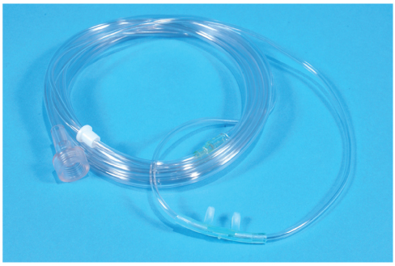
Nasal Cannulas (1 of 2)
Deliver oxygen through two small, tubelike prongs that fit into the nostrils
Can provide 24% to 44% inspired oxygen when the flowmeter is set at
1–6 L/min
FIGURE 11-40 The nasal cannula delivers oxygen directly through the nostrils.
© Jones & Bartlett Learning. Courtesy of MIEMSS.
Notes:
Lecture Outline
C. Nasal cannulas
1. Deliver oxygen through two small, tubelike prongs that fit into the patient’s nostrils
2. Can provide 24% to 44% inspired oxygen when the flowmeter is set at 1–6 L/min
a. For patient comfort, flow rates above 6 L/min are not recommended.

Slide 84
Nasal Cannulas (2 of 2)
Used in patients with mild hypoxemia
A patient who breathes through the mouth, or has a nasal obstruction, will not benefit.
When you anticipate a long transport time, consider using humidification.
Notes:
Lecture Outline
3. Used in patients with mild hypoxemia
A patient who breathes through the mouth, or has a nasal obstruction, will get little or no benefit.
Some EMS systems provide humidified oxygen during extended transports.
a. Humidification may be associated with an increased generation of aerosolized droplets of fluid capable of transmitting disease.

Slide 85
Partial Rebreathing Masks
Similar to nonrebreathing masks
  There is no one-way valve between the mask and the reservoir.
  Patients rebreathe a small amount of exhaled air.
Notes:
Lecture Outline
D. Partial rebreathing masks
1. Similar to nonrebreathing masks, except there is no one-way valve between the mask and the reservoir
2. Patients rebreathe a small amount of their exhaled air.

Slide 86
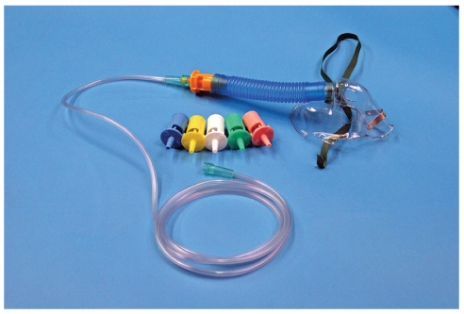
Venturi Masks
A number of settings can vary the percentage of oxygen while a constant flow is maintained.
Delivers 24%–40%
FIGURE 11-41 The Venturi mask.
© Jones & Bartlett Learning. Courtesy of MIEMSS.
Notes:
Lecture Outline
E. Venturi masks
1. Has a number of attachments can vary the percentage of oxygen while a constant flow is maintained from the regulator.
2. Medium-flow device that delivers 24%-40% depending on the manufacturer.

Slide 87
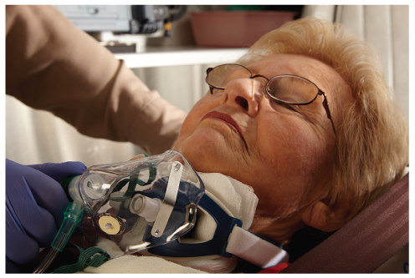
Tracheostomy Masks (1 of 2)
Patients with tracheostomies do not breathe through their mouth and nose.
FIGURE 11-42 For a patient with a tracheostomy, if you do
not have a tracheostomy mask, use a face mask instead.
© Jones & Bartlett Learning.
Notes:
Lecture Outline
F. Tracheostomy masks
1. Patients with tracheostomies do not breathe through their mouth and nose.

Slide 88
Tracheostomy Masks (2 of 2)
Tracheostomy masks cover the tracheostomy hole and have a strap that goes around the neck.
  May not be available in an emergency setting
  Improvise by using a face mask placed at the tracheostomy opening.
Notes:
Lecture Outline
2. Tracheostomy masks cover the tracheostomy hole and have a strap that goes around the neck.
a. These may not be available in an emergency setting, in which case you should improvise by placing a face mask over the stoma.

Slide 89
Assisted and Artificial Ventilation (1 of 12)
Basic airway and ventilation techniques are extremely effective.
  Follow standard precautions as needed when managing a patient’s airway.
Notes:
Lecture Outline
XII. Assisted and Artificial Ventilation
A. Basic airway and ventilation techniques are extremely effective when administered appropriately.

Slide 90
Assisted and Artificial Ventilation (2 of 12)
Signs and symptoms of inadequate ventilation:
  Altered mental status
  Inadequate minute volume
  Excessive accessory muscle use and fatigue
Notes:
Lecture Outline
1. Signs and symptoms of inadequate ventilation:
a. Altered mental status
b. Inadequate minute volume
c. Excessive accessory muscle use and fatigue

Slide 91
Assisted and Artificial Ventilation (3 of 12)
When assisting with a bag-mask device:
  Explain the procedure to the patient.
  Place the mask over the nose and mouth.
  Squeeze the bag each time the patient breathes.
  After the initial 5 to 10 breaths, deliver an appropriate tidal volume.
  Maintain an adequate minute volume.
Notes:
Lecture Outline
2. To assist a patient with ventilations using a bag-mask device:
a. Explain the procedure to the patient.
b. Place the mask over the patient’s nose and mouth.
c. Squeeze the bag each time the patient breathes, maintaining the same rate as the patient.
d. After the initial 5 to 10 breaths, slowly adjust the rate and deliver an appropriate tidal volume.
e. Adjust the rate and tidal volume to maintain an adequate minute volume.

Slide 92
Assisted and Artificial Ventilation (4 of 12)
Artificial ventilation
  Once a patient is not breathing, begin artificial ventilation immediately via:
    Mouth-to-mask technique
    One- or two-person bag-mask device
Notes:
Lecture Outline
B. Artificial ventilation
1. Once you determine that a patient is not breathing, begin artificial ventilation immediately.
2. Available methods:
a. Mouth-to-mask technique
b. One- or two-person bag-mask device

Slide 93
Assisted and Artificial Ventilation (5 of 12)
Normal ventilation versus positive pressure ventilation
  In normal breathing, the diaphragm contracts and negative pressure is generated in the chest cavity.
  Positive pressure ventilation is generated by a device that forces air into the chest cavity.
Notes:
Lecture Outline
3. Normal ventilation versus positive pressure ventilation
a. Artificial ventilations are necessary to sustain life, but they are not the same as normal breathing.
i. In normal breathing, the diaphragm contracts and negative pressure is generated in the chest cavity, which sucks air into the chest.
ii. positive pressure ventilation generated by a device forces air into the chest cavity.

Slide 94
Assisted and Artificial Ventilation (6 of 12)
With positive pressure ventilation:
  Increased intrathoracic pressure reduces the blood pumped by the heart.
  More volume is required to have the same effects as normal breathing.
  Air is forced into the stomach, causing gastric distention.
Notes:
Lecture Outline
b. With positive pressure ventilation:
i. Increased intrathoracic pressure causes compression of the vena cava and reduces blood return to the heart, which reduces the amount of blood pumped by the heart.
ii. More volume is required to have the same effects as normal breathing, which pushes the airway walls out of their normal anatomic shape.
iii. Air is forced into the stomach, causing gastric distention that could result in vomiting and aspiration.
c. The EMT must regulate the rate and volume of artificial ventilations to help prevent the drop in cardiac output.
d. Ventilation rates (for apneic patients with a pulse)
i. Adult: 1 breath per 6 seconds
ii. Child: 1 breath per 2–3 seconds
iii. Infant: 1 breath per 2–3 seconds

Slide 95
Assisted and Artificial Ventilation (7 of 12)
Mouth-to-mouth and mouth-to-mask ventilation
  Barrier device is routinely used in mouth-to-mouth ventilations.
  Mask with an oxygen inlet provides oxygen during mouth-to-mask ventilation.
Notes:
Lecture Outline
4. Mouth-to-mouth and mouth-to-mask ventilation
a. A barrier device is routinely used in mouth-to-mouth ventilations.
b. A mask with an oxygen inlet provides oxygen during mouth-to-mask ventilation.

Slide 96
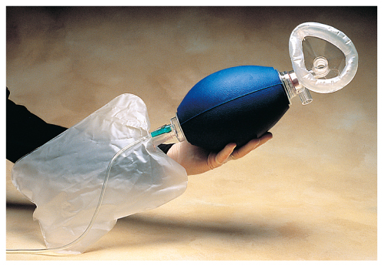
Assisted and Artificial Ventilation (8 of 12)
Bag-mask device
  Provides less tidal volume than mouth-to-mask ventilation
    An experienced EMT can provide adequate tidal volume.
FIGURE 11-45 A bag-mask device with an oxygen
reservoir can deliver nearly 100% oxygen if a good
seal between the mouth and mask is achieved and if
supplemental oxygen is used.
© American Academy of Orthopaedic Surgeons.
Notes:
Lecture Outline
5. Bag-mask device
a. Provides less tidal volume than mouth-to-mask ventilation but delivers a much higher concentration of oxygen with a flow rate of 15 L/min and a adequate mask-to-face seal.
b. Bag-mask device components
i. A disposable self-inflating mask
ii. No pop-off valve, or if one is present, the capability of disabling the popoff valve.
iii. An inline viral filter
iv. An outlet valve that is a true valve for nonrebreathing
v. An oxygen reservoir that allows for delivery of high-concentration oxygen.
vi. A one-way, no-jam inlet valve system that provides an oxygen flow rate at a maximum of 15 L/min with standard 15/22-mm fittings for face mask and endotracheal (or other advanced airway adjunct) connect).
vii. A transparent face mask.
viii. Ability to perform under extreme environmental conditions
c. The volume of air delivered is based on observing chest rise and fall
Bag-mask technique
a. To use the one-person BVM technique (Skill Drill 11-8)

Slide 97
Assisted and Artificial Ventilation (9 of 12)
Gastric distention
  Occurs when artificial ventilation fills the stomach with air
  Most likely to occur when you ventilate the patient too forcefully or too rapidly
  May also occur when the airway is obstructed
Notes:
Lecture Outline
7. Gastric distention
a. Occurs when artificial ventilation fills the stomach with air
b. Most likely to occur when:
i. You ventilate the patient too forcefully or too rapidly with a bag-mask device or pocket mask
ii. The airway is obstructed as a result of a foreign body or improper head position
c. Give slow, gentle breaths during artificial ventilation over 1 second.

Slide 98
Assisted and Artificial Ventilation (10 of 12)
Gastric distention (cont’d)
  To prevent or alleviate distention:
    Ensure the patient’s airway is appropriately positioned.
    Ventilate at the appropriate rate.
    Ventilate with the appropriate volume.
  If the stomach appears distended, recheck and reposition the head and perform rescue breathing.
Notes:
Lecture Outline
d. To prevent or alleviate distention:
i. Ensure that the patient’s airway is appropriately positioned.
ii. Ventilate the patient at the appropriate rate.
iii. Ventilate the patient with the appropriate volume.
e. If gastric distention makes it impossible to ventilate the patient and an ALS provider is not available to perform decompression, consider applying pressure over the upper abdomen (last resort).
f. If vomiting occurs as a result, turn the patient’s entire body to the side, suction and/or wipe out the mouth with your gloved hand, return the patient to a supine position, and continue rescue breathing.

Slide 99
Assisted and Artificial Ventilation (11 of 12)
Passive ventilation
  Expansion and contraction create a “pump” for air movement.
  Benefits patients who are receiving chest compressions
  Can be enhanced using oropharyngeal airway and supplemental oxygen
Notes:
Lecture Outline
8. Passive ventilation
a. Sometimes called passive oxygenation or apneic oxygenation
b. Air movement into and out of the chest cavity occurs passively as a result of compressing on the chest.
i. When the chest is compressed, air is forced out of the thorax
ii. As the chest recoils following compression, a negative pressure is created within the chest, which results in a vacuum.
iii. Air is sucked into the chest cavity, similar to what occurs with the muscle contraction during active inhalation.
c. Passive ventilation can be enhanced by inserting an oropharyngeal airway and providing supplemental oxygen.

Slide 100
Assisted and Artificial Ventilation (12 of 12)
Automatic transport ventilator (ATV)/resuscitator
  Manually triggered device attached to a control box
  Allows the variables of ventilation to be set
  Lacks the sophisticated control of a hospital ventilator
  Frees the EMT to perform other tasks
Notes:
Lecture Outline
9. Automatic transport ventilator (ATV)/resuscitator
a. The ATV is a ventilation device attached to a control box that allows the variables of ventilation to be set.
b. It frees the EMT to perform tasks such as maintaining the mask seal or ensuring continued airway patency.
c. Constant reassessment of the patient is necessary.

Slide 101
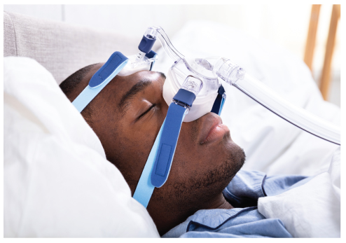
Continuous Positive Airway Pressure (CPAP) (1 of 8)
Noninvasive ventilatory support for respiratory distress
  Many people diagnosed with obstructive sleep apnea wear a CPAP unit at night.
  Becoming widely used at the EMT level
FIGURE 11-48 Many people in whom obstructive sleep
apnea has been diagnosed wear a CPAP unit at night to
maintain their airway while they sleep.
© Andrey_Popov/Shutterstock.
Notes:
Lecture Outline
XIII. Continuous Positive Airway Pressure
A. Continuous positive airway pressure (CPAP) is noninvasive ventilatory support for patients experiencing respiratory distress.
1. Many people diagnosed with obstructive sleep apnea wear a CPAP unit at night to maintain their airways while they sleep.
2. CPAP in the prehospital environment has proven to be an excellent adjunct in the treatment of respiratory distress associated with COPD, acute pulmonary, and acute bronchospasm.
3. CPAP is becoming widely used at the EMT level.

Slide 102
Continuous Positive Airway Pressure (CPAP) (2 of 8)
Mechanism
  Increases pressure in the lungs
  Opens collapsed alveoli
  Pushes more oxygen across the alveolar membrane
  Forces interstitial fluid back into the pulmonary circulation
Notes:
Lecture Outline
B. Mechanism
1. CPAP increases pressure in the lungs, opens collapsed alveoli, pushes more oxygen across the alveolar membrane, and forces interstitial fluid back into the pulmonary circulation.

Slide 103
Continuous Positive Airway Pressure (CPAP) (3 of 8)
Mechanism (cont’d)
  Therapy is delivered through a face mask held to the head with a strapping system.
  Use caution with patients with potentially low blood pressure.
Notes:
Lecture Outline
2. The therapy is typically delivered through a face mask held to the head with a strapping system.
a. A good seal with minimal leakage between the face and mask is essential.
Many CPAP systems use oxygen as the driving force to deliver the positive ventilatory pressure to the patient.
a. Patients benefit the most from CPAP during exhalation.
4. Use caution with patients with potentially low blood pressure, because CPAP causes a drop in cardiac output.

Slide 104
Continuous Positive Airway Pressure (CPAP) (4 of 8)
Indications
  Patient is alert and able to follow commands.
  Patient displays obvious signs of moderate to severe respiratory distress.
  Respiratory distress occurs after a submersion incident.
  Patient is breathing rapidly.
  Pulse oximetry reading is less than 90%.
Notes:
Lecture Outline
C. Indications
1. The patient is alert and able to follow commands.
2. The patient displays obvious signs of moderate to severe respiratory distress from a condition such as pulmonary edema or obstructive pulmonary disease (ie, COPD).
3. Respiratory distress occurs after a submersion incident.
4. The patient is breathing rapidly, such that it affects overall minute volume.
5. The pulse oximetry reading is less than 90%.

Slide 105
Continuous Positive Airway Pressure (CPAP) (5 of 8)
Contraindications
  Patient in respiratory arrest
  Patient is hypoventilating.
  Patient cannot speak.
  Patient is unresponsive or cannot follow verbal commands.
  Patient cannot protect his or her airway.
  Patient has hypotension.
Notes:
Lecture Outline
D. Contraindications
1. Patient in respiratory arrest or has agonal respirations
2. Patient is hypoventilating.
3. Patient cannot speak.
4. Patient is unresponsive or otherwise unable to follow verbal commands.
5. Patient cannot protect his or her own airway.
6. Patient has hypotension.

Slide 106
Continuous Positive Airway Pressure (CPAP) (6 of 8)
Contraindications (cont’d)
  Signs and symptoms of a pneumothorax or chest trauma
  Patient has a tracheostomy.
  Active gastrointestinal bleeding or vomiting
  Patient has experienced facial trauma.
  Patient is in cardiogenic shock.
  Patient cannot sit upright.
  Patient cannot tolerate the mask.
Notes:
Lecture Outline
D. Contraindications
7. Signs and symptoms of pneumothorax or chest trauma
8. Patient who has a tracheostomy
9. Active gastrointestinal bleeding or vomiting
10. Patient has experienced facial trauma.
11. Patient is in cardiogenic shock.
12. Patient cannot sit upright.
13. CPAP system mask and strap cannot properly fit.
14. Patient cannot tolerate the mask.

Slide 107
Continuous Positive Airway Pressure (CPAP) (7 of 8)
Application
  Resistance creates back pressure that pushes open smaller airway structures as the patient exhales.
  7.0 to 10.0 cm H₂O is acceptable.
Notes:
Lecture Outline
E. Application
1. Components of a CPAP unit:
a. Generator
b. Mask
c. Circuit containing corrugated tubing
d. Bacteria filter
e. One-way valve
2. The CPAP generator creates resistance throughout the respiratory cycle.
3. This resistance creates a back pressure into the airways that pushes open the smaller airway structures, such as bronchioles and alveoli, as the patient exhales.
4. The amount of pressure can be determined by adjusting a valve within the CPAP system or with a separate valve that can be attached.
a. A pressure of 7.0 to 10.0 cm H₂O is generally an acceptable therapeutic range.
5. Most CPAP units are powered by oxygen, so it is important to have a full cylinder of oxygen when using CPAP.
6. To use CPAP, see Skill Drill 11-9.

Slide 108
Continuous Positive Airway Pressure (CPAP) (8 of 8)
Complications
  Some patients may find CPAP claustrophobic.
  Risk of pneumothorax
  Can lower the patient’s blood pressure
  If the patient shows signs of deterioration, remove CPAP and begin positive pressure ventilation using a bag-mask device.
Notes:
Lecture Outline
F. Complications
1. Some patients may find CPAP claustrophobic and resist application of the mask.
a. Coach patients through the process rather than forcing the mask on them.
2. Due to the high volume of pressure generated by CPAP, pneumothorax is a risk.
3. High pressure in the chest can lower the patient’s blood pressure.
4. If the patient shows signs of deterioration, remove CPAP and begin positive pressure ventilation using a BVM attached to high-flow oxygen.

Slide 109
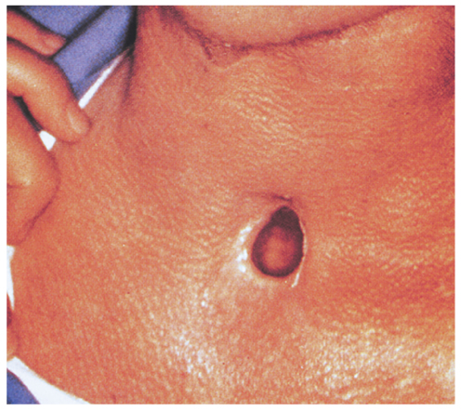
Special Considerations (1 of 3)
Stomas and tracheostomy tubes
  Patients who have had a laryngectomy have a permanent tracheal stoma.
  Known as a tracheostomy
FIGURE 11-49 A tracheal stoma is typically located in the midline of the neck. The midline opening is the only one that can be used to ventilate the patient.
© American Academy of Orthopaedic Surgeons.
Notes:
Lecture Outline
XIV. Special Considerations
A. Stomas and tracheostomy tubes
1. Patients who have had a laryngectomy have a permanent tracheal stoma, which is an opening in the neck that connects the trachea directly to the skin.
a. Known as a tracheostomy

Slide 110
Special Considerations (2 of 3)
Stomas and tracheostomy tubes (cont’d)
  Neither the head tilt–chin lift maneuver nor the jaw-thrust maneuver is required.
  If the patient has a tracheostomy tube, ventilate through the tube with a bag-mask device.
Notes:
Lecture Outline
2. If the patient has a tracheostomy tube, ventilate through the tube with a BVM.
a. A standard 15/22-mm adapter on the bag-mask device will fit onto the tube in the tracheal stoma.
b. Use 100% oxygen attached directly to the bag-mask device.

Slide 111
Special Considerations (3 of 3)
Stomas and tracheostomy tubes (cont’d)
  If the patient has a stoma but no tube is in place, use an infant or child mask with your bag-mask device to make a seal over the stoma.
  If you cannot ventilate a patient with a stoma:
    Try suctioning the stoma.
    Seal the stoma while giving mouth-to-mouth.
Notes:
Lecture Outline
3. If the patient has a stoma but no tube is in place:
a. Use an infant or child mask with your bag-mask device to make a seal over the stoma.
4. Seal the patient’s mouth and nose with one hand to prevent a leak of air through the upper airway when you ventilate through a stoma.
a. Release the seal of the patient’s mouth and nose for exhalation.
b. This allows the air to exhale through the upper airway.
5. If you cannot ventilate a patient with a stoma:
a. Try suctioning the stoma and the mouth with a French or soft-tip catheter.
b. Seal the stoma while giving mouth-to-mouth ventilation.

Slide 112
Airway Obstruction (1 of 6)
If an obstruction completely blocks the airway, it is a true emergency.
  Will result in death if not treated immediately
  In an adult, usually occurs during a meal
  In a child, can occur while eating, playing with small toys, or crawling
Notes:
Lecture Outline
XV. Foreign Body Airway Obstruction
A. If an obstruction completely blocks the airway, it is a true emergency.
1. It will result in death if not treated immediately.
2. In an adult, sudden foreign body airway obstruction usually occurs during a meal.
3. In a child, it can occur while eating, playing with small toys, or crawling around the house.

Slide 113
Airway Obstruction (2 of 6)
The tongue is the most common airway obstruction in an unconscious patient.
Causes of airway obstruction that do not involve foreign bodies:
  Swelling, from infection or acute allergic reaction
  Trauma (tissue damage from injury)
Notes:
Lecture Outline
4. By far, the most common airway obstruction in an unconscious patient is the tongue, which relaxes and falls back into the throat.
5. Causes of airway obstruction that do not involve foreign bodies:
a. Swelling, from infection or acute allergic reaction
i. Repeated attempts to clear the airway could be dangerous.
ii. These patients require specific emergency medical care.
iii. Rapid transport to the hospital is critical.
b. Trauma (tissue damage from injury)

Slide 114
Airway Obstruction (3 of 6)
Mild airway obstruction
  Patients can still exchange air but will have respiratory distress.
  Noisy breathing, wheezing, coughing
  With good air exchange, do not interfere with the patient’s efforts to expel the object on his or her own.
Notes:
Lecture Outline
B. Recognition
1. Mild airway obstruction
a. Patients can still exchange air but will have varying degrees of respiratory distress.
b. Great care must be taken to prevent a mild airway obstruction from becoming a severe airway obstruction.
c. The patient may have noisy breathing and may be coughing.
d. With good air exchange, the patient can cough forcefully, although you may hear wheezing between coughs (the production of whistling sounds during respiration).
i. As long as the patient can breathe, cough forcefully, or talk, you should not interfere with the patient’s efforts to expel the foreign object on his or her own.
ii. Continually reassess the patient’s condition.

Slide 115
Airway Obstruction (4 of 6)
Mild airway obstruction (cont’d)
  With poor air exchange, the patient may have increased difficulty breathing, stridor, and cyanosis.
  Treat immediately.
Notes:
Lecture Outline
e. With poor air exchange, the patient has a weak, ineffective cough and may have increased difficulty breathing, stridor, and cyanosis.
i. Stridor indicates mild upper airway obstruction.
ii. Treat immediately as if there is a severe airway obstruction.

Slide 116
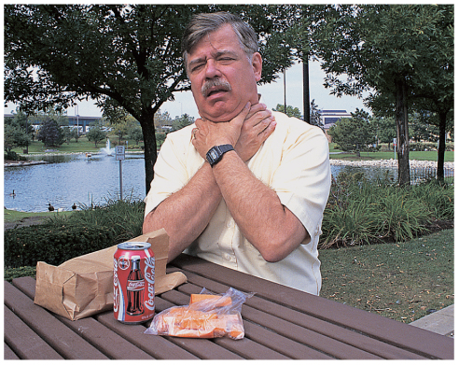
Airway Obstruction (5 of 6)
Severe airway obstruction
  Patients cannot breathe, talk, or cough.
  Patient may use the universal distress signal, begin to turn cyanotic, and have extreme difficulty breathing.
FIGURE 11-50 The universal sign of choking is a person
who grasps his or her throat and has difficulty breathing.
© Jones & Bartlett Learning. Courtesy of MIEMSS.
Notes:
Lecture Outline
2. Severe airway obstruction
a. Patients cannot breathe, talk, or cough.
b. The patient may clutch or grasp the throat (the universal distress signal), begin to turn cyanotic, and have extreme difficulty breathing.

Slide 117
Airway Obstruction (6 of 6)
Severe airway obstruction (cont’d)
  Provide immediate treatment to the conscious patient.
  If not treated, the patient will become unconscious and die.
  If the patient is unresponsive, not breathing, and has no pulse, begin CPR with chest compressions.
Notes:
Lecture Outline
c. There is little or no air movement.
d. If the patient is found unresponsive, does not appear to be breathing, and does not have a pulse, begin CPR with high-quality chest compressions.
i. When you open the airway and attempt two ventilations following chest compressions, it will be obvious if the airway is blocked.
ii. If there is no chest rise and fall after several attempts to ventilate, or if you feel resistance while ventilating, consider the possibility of an airway obstruction.

Slide 118
Emergency Medical Care for Foreign Body
Airway Obstruction
Perform a head tilt–chin lift maneuver to clear a tongue obstruction.
Large obstructions should be swept forward out of the mouth with your gloved index finger.
Abdominal thrusts are the most effective method of dislodging and forcing out an object.
Notes:
Lecture Outline
C. Emergency medical care for foreign body airway obstruction
1. Perform a head tilt–chin lift maneuver to clear a tongue obstruction.
a. If spinal trauma is suspected, open the airway with a jaw-thrust maneuver.
2. Large pieces of vomited food, mucus, loose dentures, or blood clots in the mouth should be swept forward and out of the mouth with your gloved index finger.
3. When available, perform suctioning to maintain a clear airway.
4. Abdominal thrusts are the most effective method of dislodging and forcing an object out of the airway of a conscious patient.
a. Residual air, always present in the lungs, is compressed upward and used to expel the object.
b. Use the abdominal thrusts until the object dislodges or the patient becomes unconscious.
5. For the unresponsive patient with a severe foreign body airway obstruction, reassess to confirm apnea and inability to ventilate.
6. Begin chest compression just as you would for CPR, following the 30 compressions to 2 breaths ratio.
7. At the completion of the 30 compressions, pull the jaw/mouth open and look at the back of the oropharynx for any foreign objects.
a. If you see an object, remove it with a gloved index finger or suction.
b. Never perform a blind sweep of the back of the oropharynx, which may push an object farther down in the airway, making the obstruction worse.
c. Once the object is removed, or if no object was seen, attempt to ventilate.
d. If you are still unable to ventilate, repeat the process.

Slide 119
Dental Appliances
Can cause an airway obstruction
  Examples: crown, bridge, dentures, piece of braces
  Manually remove the appliance before providing ventilations.
  Leave well-fitting dentures in place.
  Loose dentures interfere with the process and should be removed.
Notes:
Lecture Outline
D. Dental appliances
1. Many dental appliances can cause an airway obstruction.
a. Examples: a crown, a bridge, dentures, or a piece of braces
2. Manually remove the dental appliance before providing ventilations.
3. Leaving well-fitting dentures in place usually makes bag-mask device or mouth-to-mask ventilation much easier.
a. Provides more “structure” to the face
b. Helps you provide a good face-to-mask seal
4. Loose dentures interfere with the process and should be removed.
5. If possible, place dislodged dentures in a container and transport them with the patient.

Slide 120
Facial Bleeding
Airway problems can be particularly challenging in patients with serious facial bleeding.
The blood supply to the face is very rich.
  Injuries can result in severe tissue swelling and bleeding into the airway.
  Control bleeding with direct pressure, and suction as necessary.
Notes:
Lecture Outline
E. Facial bleeding
1. Airway problems can be particularly challenging in patients with serious facial injuries.
2. The blood supply to the face is very rich, so injuries can result in severe tissue swelling and bleeding into the airway.
3. Control bleeding with direct pressure and suction as necessary.

Slide 121
Assisting With ALS Airway Procedures
Placement of advanced airways
  Preoxygenation
  Equipment setup
  Performing the procedure “BE MAGIC”
    B- Perform Bag-mask preoxygenation.
    E- Evaluate for airway difficulties.
    M- Manipulate the patient.
    A- Attempt first-pass intubation.
    GI- Use a supraGlottic airway if unable to intubate.
    C- Confirm successful intubation/Correct issues.
Notes:
Lecture Outline
XVI. Assisting with ALS Airway Procedures
A. When a critical patient needs and advanced airway intervention, the paramedic will perform the skill, but the EMT will play an essential role in helping set up for the procedure, performing BLS airway and ventilation maneuvers, and helping to monitor the patient.
B. Assisting with placement of advanced airways
1. Endotracheal intubation
a. The first step is preoxygenation which often includes bag-mask ventilation (including the use of an oral or nasal airway) and ensuring a proper seal, ventilation rate, volume of ventilation, and time for patient exhalation.
b. Maintain a high-flow nasal cannula on the patient during the preoxygenation phase and leave the nasal cannula in place during the intubation attempt.
i. Called preoxygenation
c. Equipment setup
i. Personal protective equipment, including face mask and eye shield
ii. Suction unit with rigid, tonsil-tip and nonrigid, whistle-tip catheters
iii. Laryngoscope handle and blade
iv. Magill forceps
v. ET tube
vi. Stylette or tube introducer (gum elastic bougie)
vii. Water-soluble lubricant
viii. 10-mL syringe
xiv. Confirmation device or devices
xv. Commercial ET tube securing device
xvi. Alternate airway management devices, such as a supraglottic airway and/or cricothyrotomy kit
d. Performing the procedure
i. Remember six typical steps by using the BE MAGIC mnemonic
(a) B Perform Bag-mask preoxygenation
(b) E Evaluate for airway difficulties
(c) M Manipulate the patient
(d) A Attempt first-pass intubation
(e) GI Use a supraGlottic airway if unable to intubate
(f) C Confirm successful intubation/Correct any issues
e. Monitor for signs of potential compensation
i. Absence of an end-tidal CO₂ level
ii. Decreasing SpO₂ level
iii. Increasing resistance when ventilating
iv. Other physical signs of poor ventilation and perfusion
v. Improper positioning or dislodgement of the ET tube

Slide 122
Review
Breathing is controlled by an area in the:
  lungs.
  brainstem.
  spinal cord.
  diaphragm.

Slide 123
Review
Answer: B
Rationale: The pons and the medulla are the respiratory centers in the brainstem that control breathing.

Slide 124
Review
Breathing is controlled by an area in the:
  lungs.
  Rationale: The lungs contain small pockets called alveoli where the exchange of oxygen and carbon dioxide takes place.
  brainstem.
  Rationale: Correct answer
  spinal cord.
  Rationale: Impulses are sent down the spinal cord from the brainstem.
  diaphragm.
  Rationale: The diaphragm receives the impulses that cause it to contract and bring air in.

Slide 125
Review
The EMT should assess a patient’s tidal volume by:
  observing for adequate chest rise.
  assessing the facial area for cyanosis.
  counting the patient’s respiratory rate.
  measuring the patient’s oxygen saturation.

Slide 126
Review
Answer: A
Rationale: Tidal volume—the volume of air that is moved into or out of the lungs in a single breath—is assessed by observing for adequate chest rise. If shallow chest rise is noted, the patient’s tidal volume is likely reduced.

Slide 127
Review
The EMT should assess a patient’s tidal volume by:
  observing for adequate chest rise.
  Rationale: Correct answer
  assessing the facial area for cyanosis.
  Rationale: Cyanosis is an indication of hypoxia, rather than tidal volume.
  counting the patient’s respiratory rate.
  Rationale: Counting the respiratory rate gives you minute volume: the number of times a patient breaths in 1 minute.
  measuring the patient’s oxygen saturation.
  Rationale: Oxygen saturation is an indication of tissue perfusion, which is the amount of oxygen attached to the hemoglobin.

Slide 128
Review
In an otherwise healthy individual, the primary stimulus to breathe is a(n):
  increased level of oxygen in the blood.
  decreased level of oxygen in the blood.
  increased level of carbon dioxide in the blood.
  decreased level of carbon dioxide in the blood.

Slide 129
Review
Answer: C
Rationale: Under control of the brainstem, rising levels of carbon dioxide in arterial blood normally stimulate breathing in an otherwise healthy patient.

Slide 130
Review
In an otherwise healthy individual, the primary stimulus to breathe is a(n):
  increased level of oxygen in the blood.
  Rationale: Increased levels of oxygen can be a result of hyperventilation syndrome.
  decreased level of oxygen in the blood.
  Rationale: This is typically not normal in healthy individuals. It can be a sign of inadequate breathing and results in hypoxia.
  increased level of carbon dioxide in the blood.
  Rationale: Correct answer
  decreased level of carbon dioxide in the blood.
  Rationale: This is usually not seen in healthy adults. It is typically a result of hyperventilation syndrome.

Slide 131
Review
Signs of adequate breathing in the adult include all of the following, EXCEPT:
  pink, warm, dry skin.
  shallow chest rise.
  symmetrical chest movement.
  a respiratory rate of 16 breaths/min.

Slide 132
Review
Answer: B
Rationale: Signs of inadequate breathing in the adult include a respiratory rate less than 12 breaths/min or greater than 20 breaths/min, shallow chest rise (reduced tidal volume), cyanosis, and asymmetrical chest movement (both sides of the chest do not move equally).

Slide 133
Review
Signs of adequate breathing in the adult include all of the following, EXCEPT:
  pink, warm, dry skin.
  Rationale: This shows that breathing and perfusion are adequate.
  shallow chest rise.
  Rationale: Correct answer
  symmetrical chest movement.
  Rationale: This shows that the mechanical process of breathing is adequate, equal, and symmetrical bilaterally.
  a respiratory rate of 16 breaths/min.
  Rationale: This is a normal respiratory rate for an adult.

Slide 134
Review
During insertion of an oropharyngeal airway into an unconscious patient, she begins to vomit. The first thing you should do is:
  turn the patient on her side.
  remove the airway at once.
  suction the patient’s mouth.
  use a smaller-sized oral airway.

Slide 135
Review
Answer: A
Rationale: Whenever an unconscious patient begins to vomit—whether you are inserting an oropharyngeal airway or not—you should immediately turn the patient onto his or her side; this will allow drainage of vomit from the mouth and prevent aspiration. After the patient is on his or her side, remove the oral airway and suction the mouth.

Slide 136
Review
During insertion of an oropharyngeal airway into an unconscious patient, she begins to vomit. The first thing you should do is:
  turn the patient on her side.
  Rationale: Correct answer
  remove the airway at once.
  Rationale: Remove the airway after the patient has been rolled onto her side.
  suction the patient’s mouth.
  Rationale: This must be completed after the patient is positioned and the airway is removed.
  use a smaller-sized oral airway.
  Rationale: Oropharyngeal airways are contraindicated if the patient has a gag reflex.

Slide 137
Review
In which of the following patients would a nasopharyngeal airway be contraindicated?
  A semiconscious patient with a gag reflex
  An unconscious patient with an intact gag reflex
  A patient who fell 20 feet and landed on his or her head
  An unconscious patient who gags when you insert an oral airway

Slide 138
Review
Answer: C
Rationale: Nasopharyngeal (nasal) airways are contraindicated in patients with severe head or facial injuries and should be used with caution in patients who have delicate nasal membranes or are prone to nosebleeds. The nasal airway is better tolerated in patients who are semiconscious and/or those with a gag reflex.

Slide 139
Review
In which of the following patients would a nasopharyngeal airway be contraindicated?
  A semiconscious patient with a gag reflex
  Rationale: This airway works best with an intact gag reflex.
  An unconscious patient with an intact gag reflex
  Rationale: This airway works best with an intact gag reflex.
  A patient who fell 20 feet and landed on his or her head
  Rationale: Correct answer
  An unconscious patient who gags when you insert an oral airway
  Rationale: This airway can be used when the patient gags with an oral airway.

Slide 140
Review
You are delivering oxygen to a patient with a nasal cannula at 4 L/min when he begins to complain of a burning sensation in his nose. You should:
  A. remove the nasal cannula.
  B. apply a nonrebreathing mask.
  C. attach an oxygen humidifier.
  D. increase the flow rate to 6 L/min.

Slide 141
Review
Answer: C
Rationale: Administering “dry” oxygen through a nasal cannula—especially over a prolonged period of time—can result in drying of the nasal membranes, in which case the patient might complain of a burning sensation in the nose. Humidified oxygen will serve to keep the nasal membranes moist.

Slide 142
Review
You are delivering oxygen to a patient with a nasal cannula at 4 L/min when he begins to complain of a burning sensation in his nose. You should:
  remove the nasal cannula.
  Rationale: The oxygen should be humidified.
  apply a nonrebreathing mask.
  Rationale: This can still cause an irritation due to providing “dry” oxygen.
  attach an oxygen humidifier.
  Rationale: Correct answer
  increase the flow rate to 6 L/min.
  Rationale: The oxygen should be humidified.

Slide 143
Review
A patient is found unconscious after falling from a third-floor window. His respirations are slow and irregular. You should:
  place him in the recovery position.
  apply oxygen via a nonrebreathing mask.
  suction his airway for up to 15 seconds.
  assist his breathing with a bag-mask device.

Slide 144
Review
Answer: D
Rationale: The patient is not breathing adequately. Slow, irregular respirations will not result in adequate oxygenation. You should assist the patient’s breathing with a bag-mask device attached to 100% oxygen. Suctioning is indicated if the patient has blood or other liquids in the airway; there is no evidence of this in the scenario.

Slide 145
Review
A patient is found unconscious after falling from a third-floor window. His respirations are slow and irregular. You should:
  place him in the recovery position.
  Rationale: Due to the significant MOI, the patient should be placed supine on a long backboard with the head immobilized.
  apply oxygen via a nonrebreathing mask.
  Rationale: A bag-mask device is indicated if the patient’s respirations are less than 8 breaths/min.
  suction his airway for up to 15 seconds.
  Rationale: Suction is indicated if a patient has blood or other secretions in the airway.
  assist his breathing with a bag-mask device.
  Rationale: Correct answer

Slide 146
Review
When ventilating an apneic adult with a bag-mask device, you should squeeze the bag:
  until it is empty.
  over a period of 2 seconds.
  at a rate of 20 breaths/min.
  until visible chest rise is noted.

Slide 147
Review
Answer: D
Rationale: When ventilating any apneic patient with a bag-mask device, you should squeeze the bag over a period of 1 second and observe for visible chest rise. Ventilate the apneic adult at a rate of 10 breaths/min (one breath every 6 seconds). Ventilate infants and children at a rate of 20 to 30 breaths/min (one breath every 2 to 3 seconds).

Slide 148
Review
When ventilating an apneic adult with a bag-mask device, you should squeeze the bag:
  until it is empty.
  Rationale: An appropriately sized bag for an adult will not totally empty.
  over a period of 2 seconds.
  Rationale: You should squeeze the bag over a period of 1 second.
  at a rate of 20 breaths/min.
  Rationale: Ventilate the apneic adult at a rate of 10 breaths/min (or one breath every 6 seconds).
  until visible chest rise is noted.
  Rationale: Correct answer

Slide 149
Review
You and your partner are ventilating an apneic adult when you notice that his stomach is becoming distended. You should:
  suction his airway for up to 15 seconds.
  reposition his head.
  increase the rate and volume of your ventilations.
  decrease your ventilation rate but use more volume.

Slide 150
Review
Answer: B
Rationale: Gastric distention occurs when air enters the stomach. Severe gastric distention can result in vomiting and aspiration if not recognized and treated. To minimize the amount of air that enters the stomach during ventilations, you should reposition the patient’s head.

Slide 151
Review
You and your partner are ventilating an apneic adult when you notice that his stomach is becoming distended. You should:
  suction his airway for up to 15 seconds.
  Rationale: Suctioning is indicated when there is blood or secretions in the airway.
  reposition his head.
  Rationale: Correct answer
  increase the rate and volume of your ventilations.
  Rationale: This action may result in even more air going into the stomach.
  decrease your ventilation rate but use more volume.
  Rationale: This action may result in even more air going into the stomach.

